Slide 1
The Brightness Dependent Error Budget
Bijan Nemati
Original version: 10/22
Revision 1: 12/22

Slide 2
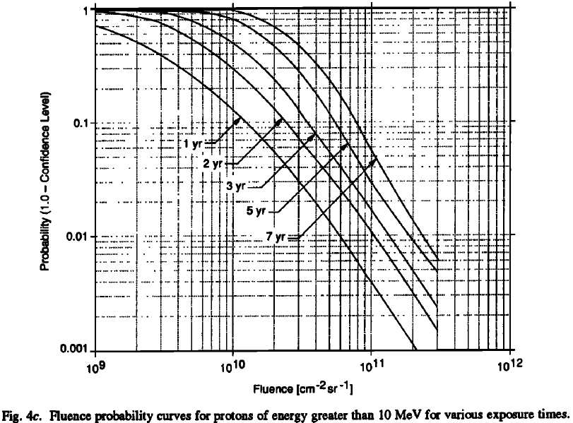
Added 1/24/17 – per Patrick email
See attached excellent paper by Joan Feynman and refer to fig 4c.
Take rdf1=95% confidence, rdf2=98% confidence
according to f4c (very coarsely, by eye),
3yrs 5yrs 7yrs 6yrs
RDF1 5e10 8e10 1.1e11 9.5e10
RDF2 9e10 1.2e11 1.8e11 1.5e11
6 yrs is last because i interpolate between 5 and 7 to get 6.
so roughly speaking, you expect 2x the fluence at 6 years as you do in 3 years, therefore roughly speaking rdf1 at 6 years is equal to rdf2 at 3 years. what you don’t know is when that fluence will be deposited.
note that i expect rdf2 fluence to be exactly 2*rdf1 fluence, so the fact that my numbers above aren’t exactly lining up i think must be my coarse reading of the figure. but it gives the idea.

Slide 3


zodi
speckle
CIC
planet
Pixel
Parallel + Serial Transfer
EM Gain
Counting
$$i_{d}$$
QE
CTE
$$ε_{pc}$$

Slide 4
Revision Notes
Revision | Date | Notes
0 | 10/22/16 | Presented initially at the ISE meeting
1 | 12/22/16 | Updates to definitions and equations, and the setting of a threshold scenario to be used for detector requirements

Slide 5
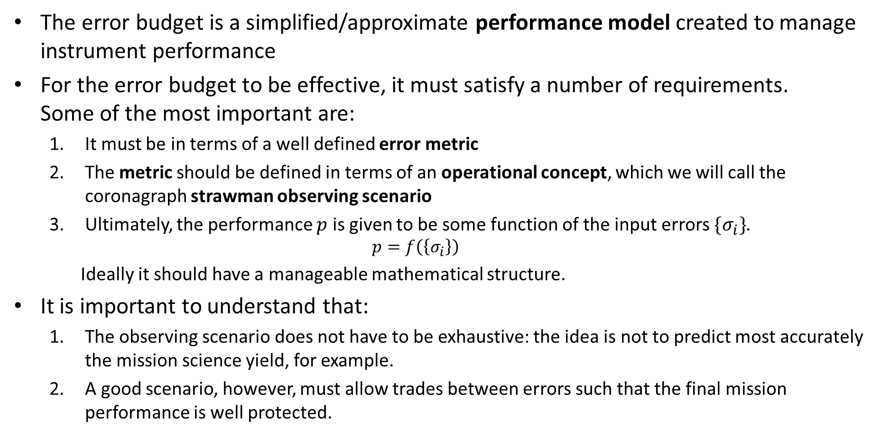
Error Budget Fundamentals
The error budget is a simplified/approximate performance model created to manage instrument performance
For the error budget to be effective, it must satisfy a number of requirements. Some of the most important are:
It must be in terms of a well defined error metric
The metric should be defined in terms of an operational concept, which we will call the coronagraph strawman observing scenario
Ultimately, the performance $p$ is given to be some function of the input errors $\{σ_{i}\}$.
$$p=f\left(\left\{σ_{i}\right\}\right)$$ Ideally it should have a manageable mathematical structure.
It is important to understand that:
The observing scenario does not have to be exhaustive: the idea is not to predict most accurately the mission science yield, for example.
A good scenario, however, must allow trades between errors such that the final mission performance is well protected.

Slide 6
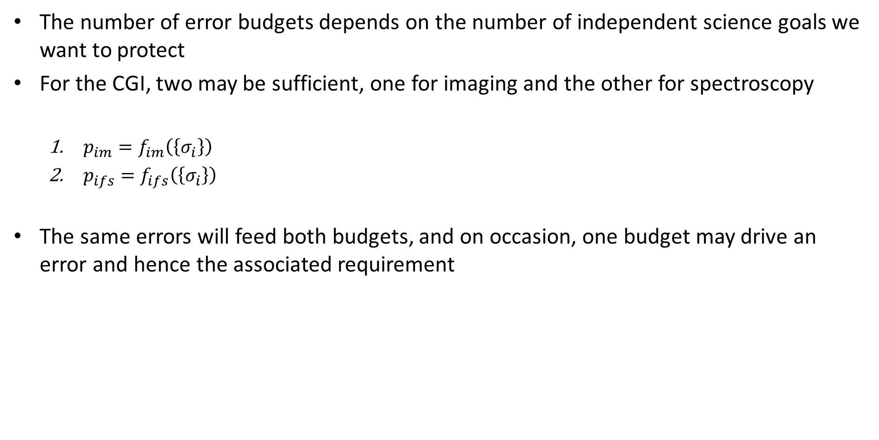
How Many Error Budgets?
The number of error budgets depends on the number of independent science goals we want to protect
For the CGI, two may be sufficient, one for imaging and the other for spectroscopy
$p_{im}=f_{im}\left(\left\{σ_{i}\right\}\right)$
$p_{ifs}=f_{ifs}\left(\left\{σ_{i}\right\}\right)$
The same errors will feed both budgets, and on occasion, one budget may drive an error and hence the associated requirement

Slide 7
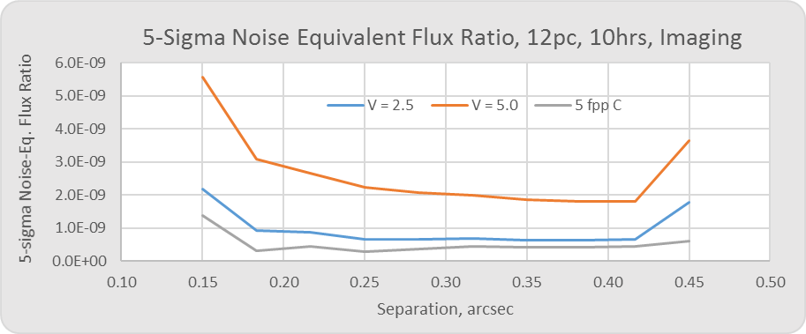

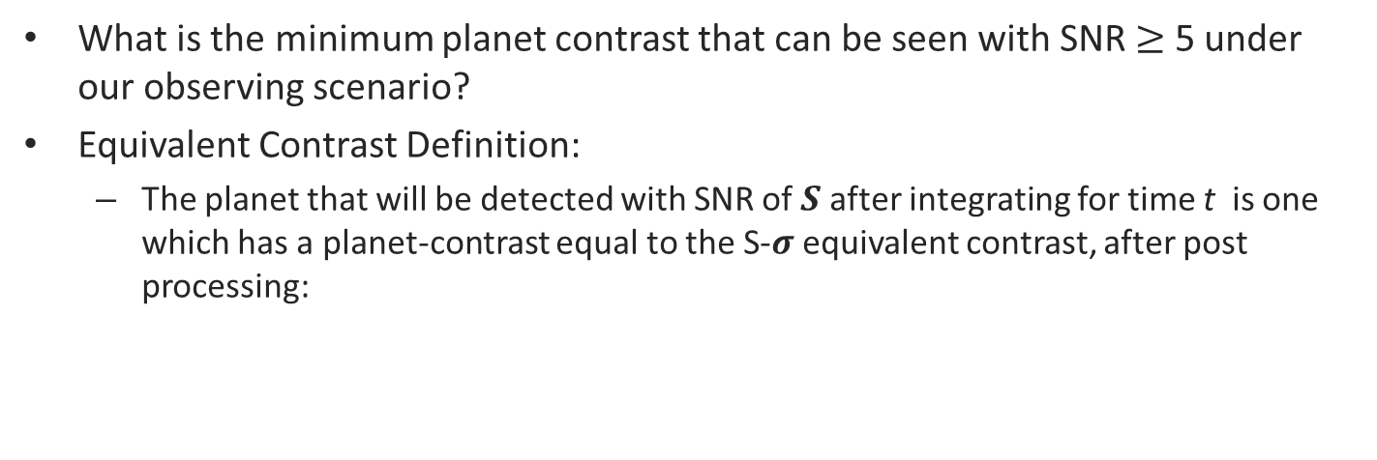


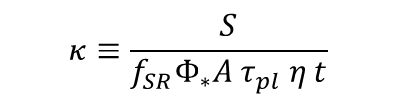


Noise Equivalent Contrast (NEC): $ξ_{eq}$
What is the minimum planet contrast that can be seen with SNR $≥$ 5 under our observing scenario?
Equivalent Contrast Definition:
The planet that will be detected with SNR of 𝑺 after integrating for time t is one which has a planet-contrast equal to the S-𝝈 equivalent contrast, after post processing:
signal
fraction
R
Planet signal in the core region after t seconds
area
QE
How dim a planet can be seen with SNR = S ?
$${f_{SR}⋅Φ}_{∗}ξ_{eq}{A τ}_{pl} η t=S{⋅σ}_{tot}$$
flux
thruput
time
T
$$ξ_{eq}=κ{⋅σ}_{tot}$$
$$κ≡\frac{S}{{f_{SR}Φ}_{∗}{A τ}_{pl} η t}$$
This conversion factor is set by the scenario parameters
$$ξ_{eq}^{V=5}$$
$$ξ_{eq}^{V=2.5}$$

Slide 8
Detector requirements from Threshold
Threshold science
Minimum science that the instrument is being designed to meet
Baseline science
Additional capability that the instrument will target on a best-effort basis, subject to cost and schedule constraints
Detector requirements will be based on threshold

Slide 9
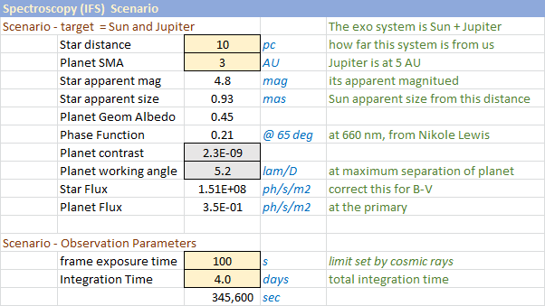
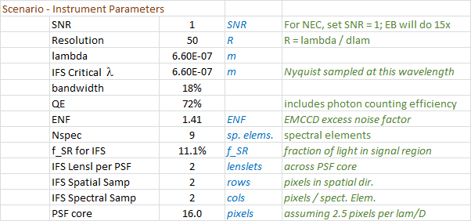





Defining The Threshold
Threshold is chosen as a Jupiter at 3 AU from a sun at 10 pc
Many other parameters also need to be set in the scenario
Planet contrast is used to set the top level allocation
Planet contrast is given by:
Geometric albedo
$$C_{pl}=A_{g}⋅φ\left(α\right)⋅{\left(\frac{r_{p}}{a}\right)}^{2}$$
Phase function
Exo system
LOS
$$a$$
$$r_{p}$$
$$α$$
planet
$$α=phase angle$$
Observer

Slide 10
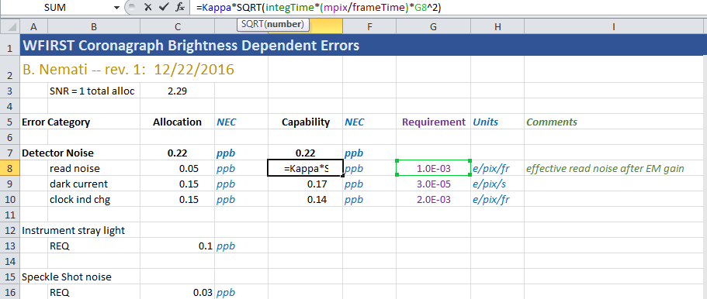
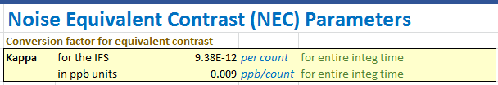

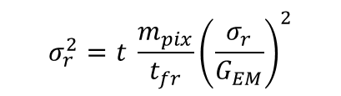

BDE Error Budget Structure
$$σ_{r}^{2}=t \frac{m_{pix}}{t_{fr}}{\left(\frac{σ_{r}}{G_{EM}}\right)}^{2}$$
$$σ_{d}^{2}=t F^{2}i_{d}m_{pix}$$
$$σ_{CIC}^{2}={t F}^{2}q_{CIC}\frac{m_{pix}}{t_{fr}}$$

Slide 11
backup

Slide 12

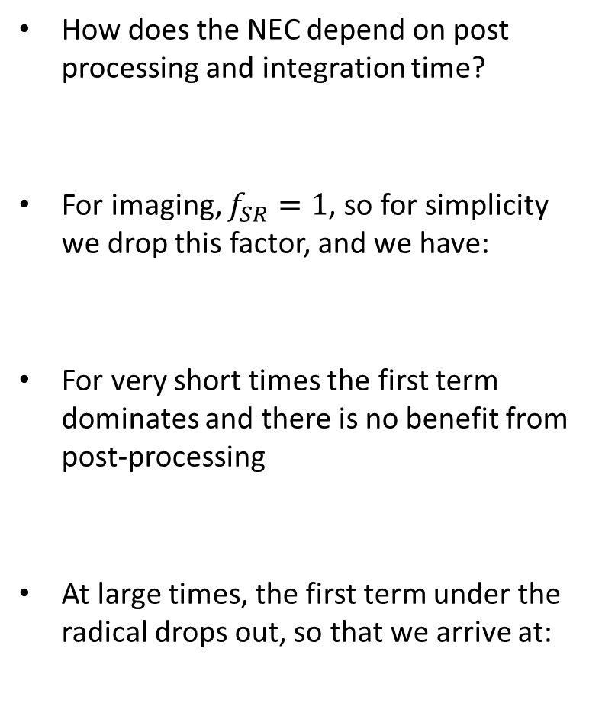





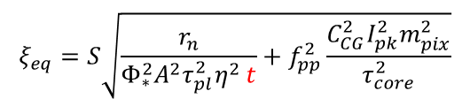
Asymptotic Behavior of $ξ_{eq}$
How does the NEC depend on post processing and integration time?
For imaging, $f_{SR}=1$, so for simplicity we drop this factor, and we have:
For very short times the first term dominates and there is no benefit from post-processing
At large times, the first term under the radical drops out, so that we arrive at:
Our definitions of NEC:
$$Φ_{∗}ξ_{eq}{A τ}_{pl} η t=S\sqrt{r_{n}t+f_{pp}^{2}r_{sp}^{2}t^{2}}$$
$$σ_{tot}$$
$$ξ_{eq}=S\sqrt{\frac{r_{n}}{Φ_{∗}^{2}{A^{2}τ}_{pl}^{2}η^{2} t}+f_{pp}^{2}\frac{C_{CG}^{2}I_{pk}^{2}m_{pix}^{2}}{τ_{core}^{2}}}$$
$σ_{t}$ dominated; not much benefit
from post-processing
$$ξ_{eq}$$
t
$$ξ_{eq} \underset{→}{\text{t}→∞} S f_{pp}\left(t\right)\frac{C_{CG}I_{pk}m_{pix}}{τ_{core}}$$

Slide 13
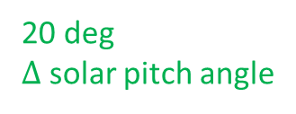
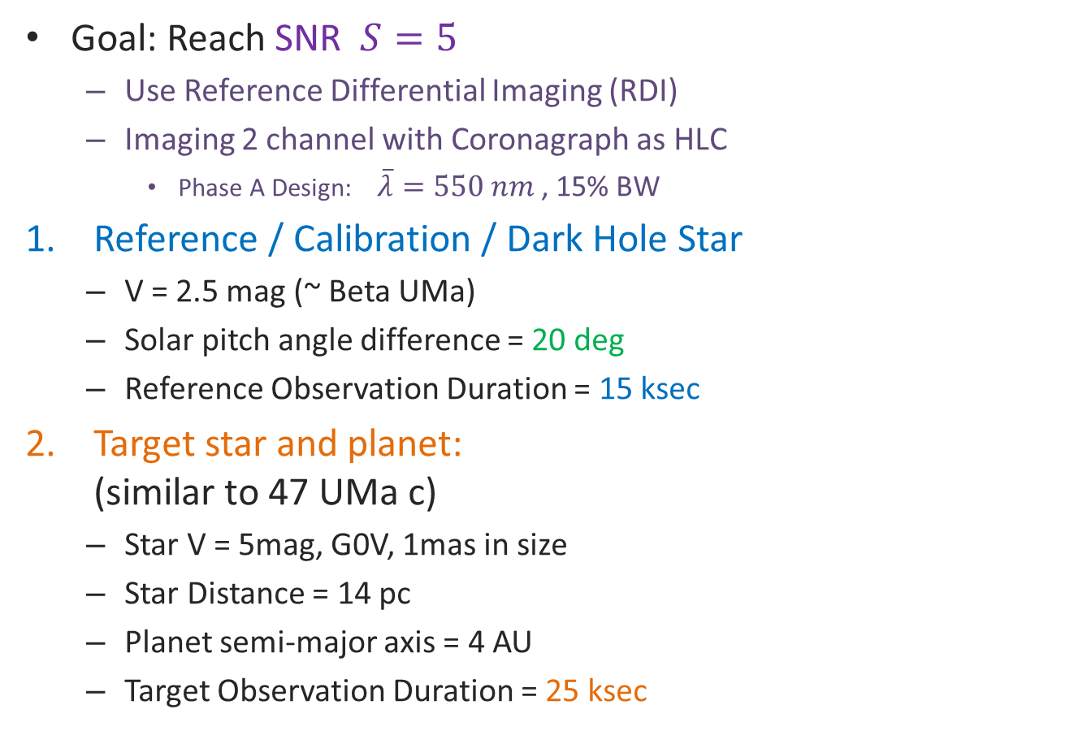


Proposed Strawman Observing Scenario: Imaging
Goal: Reach SNR $S=5$
Use Reference Differential Imaging (RDI)
Imaging 2 channel with Coronagraph as HLC
Phase A Design: $\overline{λ}=550 nm$ , 15% BW
Reference / Calibration / Dark Hole Star
V = 2.5 mag (~ Beta UMa)
Solar pitch angle difference = 20 deg
Reference Observation Duration = 15 ksec
Target star and planet: (similar to 47 UMa c)
Star V = 5mag, G0V, 1mas in size
Star Distance = 14 pc
Planet semi-major axis = 4 AU
Target Observation Duration = 25 ksec
1
20 deg $Δ$ solar pitch angle
Bright star for acquisition of DH
$$V=2.5mag$$
Science star
2
15 ksec
$$V=5 mag$$
25 ksec
The IFS scenario is similar, but with different durations and coronagraph settings. The target observation duration can be set to 450 ksec for IFS1

Slide 14




Analytical Expression for SNR
Photometric SNR means we include planet shot noise
Keep in mind that we are considering the post speckle-subtraction SNR
We write the total noise as:
The uncorrelated, random noise is given by:
Note: This is the post-subtraction error, and should in principle reflect noise contributions for both the target and reference images. However, consistent with our assumption that the reference is significantly brighter than the target, we consider the error being dominated by the target star image only.
$$SNR≡S=\frac{P}{σ_{tot}}$$
$$P=r_{pl} t$$
planet signal
$$σ_{tot}^{2}=σ_{r}^{2}+σ_{s}^{2}$$
random,
uncorrelated, reduces with t
Speckle subtraction error, excluding measurement noise
planet
speckle
zodi
dark
clk. Ind. Chg.
read noise
$$\frac{σ_{r}^{2}}{t}=r_{n}={f_{SR} F}^{2}\left[{Φ_{∗} C_{pl} τ_{pl}+Φ}_{∗}C_{CG}I_{pk}m_{pix}τ_{sp}+\left(\frac{dΦ_{Z}}{dΩ} ΔΩ_{PSF}\right)τ_{Z}\right] A_{PM} η+F^{2}\left[i_{d}m_{pix}+q_{CIC}\frac{m_{pix}}{t_{fr}}\right]+\frac{m_{pix}}{t_{fr}}{\left(\frac{σ_{rd}}{G_{EM}}\right)}^{2}$$
photonic (shot noise) terms
electronic terms
$f_{SR}≡$ fraction of core light in region of interest for SNR
$F≡$ EMCCD excess noise factor $∼\sqrt{2}$
$Φ_{∗}=F_{λ}⋅Δλ$ $Φ_{Z}=F_{λ}^{Z}⋅Δλ$

Slide 15

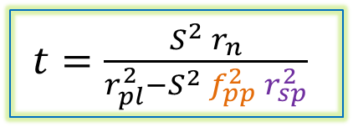

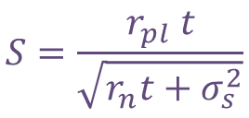
Putting it all together: time to reach SNR
planet rate
Analytical expression for SNR:
Speckle Subtraction Error:
Time to reach desired SNR:
$$S=\frac{r_{pl} t}{\sqrt{r_{n}t+σ_{s}^{2}}}$$
noise rate
$$σ_{s}=f_{pp} r_{sp} t$$
mean speckle rate
OWA
Dark Hole
IWA ~ 3 λ/D
$t=\frac{S^{2} r_{n}}{r_{pl}^{2}−S^{2}{ f}_{pp}^{2} r_{sp}^{2}}$
ROI

Slide 16
Due Jan 6!
Jan 11 (w/ SIT), Jan 31 = detec TIM
Needed
In the main photometry calculator
Two new CG columns: SPC and HLC testbed measured best results
Contrast is straightforward, identify which other parameters are guesses and which are measured
Reference planetary system in addition to the standard RV targets
In the error budget - set to end of life performance
Calculate for the testbed case, the non-detec contributions
Set up a reference system
Subtract to get top level detector allocation
See if it makes sense
If not, then detector is a technology element
For each of the likely RV planets, express the ph/s entering the telescope (no sec obsc,. Etc)
For imaging 2
IFS 1
Throughput
CG part – 3 masks
Rest of the optics

